Slide 1
DATA STRUCTURES & ALGORITHMS IN C
TREES

Slide 2
Introduction
Data structure such as Arrays, Stacks, Linked List and Queues are linear data structure. Elements are arranged in linear manner i.e. one after another.
Tree is a non-linear data structure.
Tree imposes a Hierarchical structure, on a collection of items.
Several Practical applications
Organization charts.
Family hierarchy
Representation of algebraic expression

Slide 3
Introduction
Representation of algebraic expression
Z=(J - K) / ((L * M) + N)
/
-
+
J
K
٭
N
L
M

Slide 4
Draw its equivalent algebraic expression tree:
3 ∗ x/(8 − 3) + x ∗ (4 + 2)

Slide 5
Draw its equivalent algebraic expression tree:
3 + (5 ∗ 2 − 7)

Slide 6
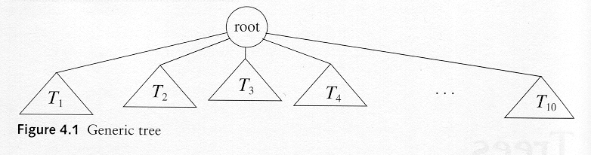
Tree Definition
A tree is a collection of nodes
The collection can be empty
If not empty, a tree consists of a distinguished node R (the root), and zero or more nonempty subtrees T₁, T₂, ...., T_{k}, each of whose roots are connected by a directed edge from R.

Slide 7
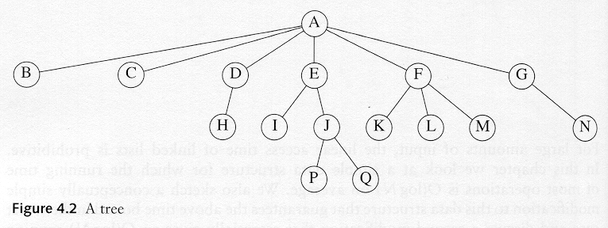
Tree

Slide 8
Tree Terminologies
A
B
C
Root
It is the mother node of a tree structure. This tree does not have parent. It is the first node in hierarchical arrangement.
Node
The node of a tree stores the data and its role is the same as in the linked list. Nodes are connected by the means of links with other nodes.
Parent
It is the immediate predecessor of a node. In the figure A is the parent of B and C.

Slide 9
Tree Terminologies
A
B
C
Child
When a predecessor of a node is parent then all successor nodes are called child nodes. In the figure B and C are the child nodes of A
Link / Edge
An edge connects the two nodes. The line drawn from one node to other node is called edge / link. Link is nothing but a pointer to node in a tree structure.
Leaf
This node is located at the end of the tree. It does not have any child hence it is called leaf node.

Slide 10
Tree Terminologies
Level
Level is the rank of tree hierarchy. The whole tree structured is leveled. The level of the root node is always at 0. the immediate children of root are at level 1 and their children are at level 2 and so on.
Height
The highest number of nodes that is possible in a way starting from the first node (ROOT) to a leaf node is called the height of tree. The formula for finding the height of a tree , where h is the height and i is the max level of the tree
Root node
Interior nodes
Height
Leaf nodes

Slide 11
Tree Terminologies
Sibling
The child node of same parent are called sibling. They are also called brother nodes.
Degree of a Node
The maximum number of children that exists for a node is called as degree of a node.
Terminal Node
The node with degree zero is called terminal node or leaf.
Path length.
Is the number of successive edges from source node to destination node.
Ancestor and descendant
Proper ancestor and proper descendant

Slide 12
Tree Terminologies
Depth
Depth of a binary tree is the maximum level of any leaf of a tree.
Forest
It is a group of disjoint trees. If we remove a root node from a tree then it becomes the forest. In the following example, if we remove a root A then two disjoint sub-trees will be observed. They are left sub-tree B and right sub-tree C.
A
B
C
D
E
F

Slide 13
Binary Trees
The simplest form of tree is a binary tree. A binary tree consists of
a node (called the root node) and
left and right sub-trees. Both the sub-trees are themselves binary trees
We now have a recursively defined data structure.
Also, a tree is binary if each node of it has a maximum of two branches i.e. a node of a binary tree can have maximum two children.

Slide 14
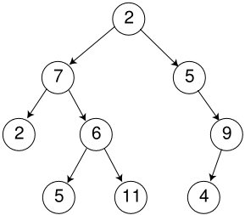
A Binary Tree

Slide 15
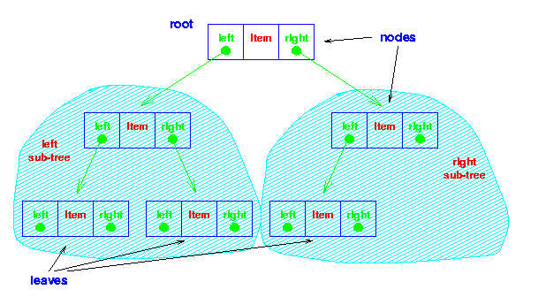
Binary Tree

Slide 16
Notation
node
root
left subtree
right subtree
A
B
C
D
E
F
G
H
I
It consists of a root and two subtrees

Slide 17
Notation
A
B
C
D
E
F
G
H
I
edge –
there is an edge from the root to its children

Slide 18
Notation
A
children
B
C
D
E
F
G
H
I

Slide 19
Notation
A
children
B
C
D
E
F
G
H
I
Who are node A’s children?

Slide 20
Notation
A
children
B
C
Who are node C’s children?
D
E
F
G
H
I
Who are node A’s children?

Slide 21
Notation
A
descendants
B
C
D
E
F
G
H
I
Who are node A’s descendants?

Slide 22
Notation
A
descendants
B
C
Who are node C’s descendants?
D
E
F
G
H
I
Who are node A’s descendants?

Slide 23
Notation
A
parents
B
C
Who is node E’s parent?
D
E
F
G
H
I

Slide 24
Notation
A
parents
B
C
Who is node E’s parent?
D
E
F
G
H
I
Who are node H’s parent?

Slide 25
Notation
A
ancestors
B
C
Who are node D’s ancestors?
D
E
F
G
H
I

Slide 26
Notation
A
ancestors
B
C
Who are node D’s ancestors?
D
E
F
G
H
I
Who are node H’s ancestors?

Slide 27
Notation
from J to A
A
B
C
path –
If n₁, n₂,…n_{k} is a sequence of nodes such that n_{i} is the parent of n_{i}+1, then that sequence is a path.
D
E
F
G
H
I
The length of the path is k-1.
J

Slide 28
Notation
From D to A
A
B
C
2
D
E
F
depth –
the length of the path from the root of the tree to the node
G
H
I

Slide 29
Notation
0
A
1
B
C
2
D
E
F
3
G
H
I
level –
all nodes of depth d are at level d in the tree

Slide 30
Notation
A
B
C
D
E
F
leaf node –
any node that has two
empty children
G
H
I

Slide 31
Notation
A
B
C
D
E
F
internal node –
any node that has at least one
non-emptyChild
Or
An internal node of a tree is any node which has degree greater than one.
G
H
I

Slide 32
Binary Trees
Some Binary Trees
One node
Two nodes
Three nodes

Slide 33
Strictly Binary Tree
When every non-leaf node in binary tree is filled with left and right sub-trees, the tree is called strictly binary tree.
A
B
C
D
E
F
G

Slide 34
Complete Binary Tree
A Complete binary tree is:
A tree in which each level of the tree is completely filled.
Except, possibly the bottom level.
A
B
C
D
E
F
G
H
I
J

Slide 35
Dynamic Implementation of Binary Tree
Linked Implementation

Slide 36
Structure Definition of Binary Tree Using Dynamic Implementation
The fundamental component of binary tree is node.
In binary tree node should consist of three things.
Data
Stores given values
Left child
is a link field and hold the address of its left node
Right child.
Is a link field and holds the address of its right node.
struct node
{
int data
node *left_child;
node *right_child;
};

Slide 37
Operations on Binary Tree
Create
Create an empty binary tree
Empty
Return true when binary tree is empty else return false.
Lchild
A pointer is returned to left child of a node, when a node is without left child, NULL pointer is returned.
Rchild
A pointer is returned to right child of a node, when a node is without left child, NULL pointer is returned.
Father/Parent
A pointer to father of a node is returned.

Slide 38
Operations on Binary Tree
Sibling
A pointer to brother of the node is returned or else NULL pointer is returned.
Tree Traversal
Inorder Traversal
Preorder Traversal
Postorder Traversal
Insert
To insert a node
Deletion
To delete a node
Search
To search a given node
Copy
Copy one tree into another.

Slide 39
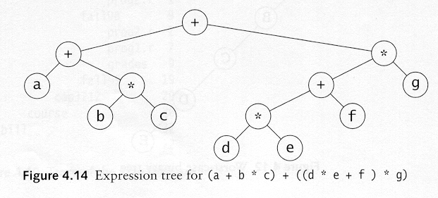
Example: Expression Trees
Leaves are operands (constants or variables)
The other nodes (internal nodes) contain operators

Slide 40
Traversal of a Binary Tree
Used to display/access the data in a tree in a certain order.
In traversing always right sub-tree is traversed after left sub-tree.
Three methods of traversing
Preorder Traversing
Root – Left –Right
Inorder Traversing
Left – Root – Right
Postorder Traversing
Left – Right - Root

Slide 41
Preorder Traversal
Preorder traversal
Node – Left – Right
Prefix expression
++a*bc*+*defg

Slide 42
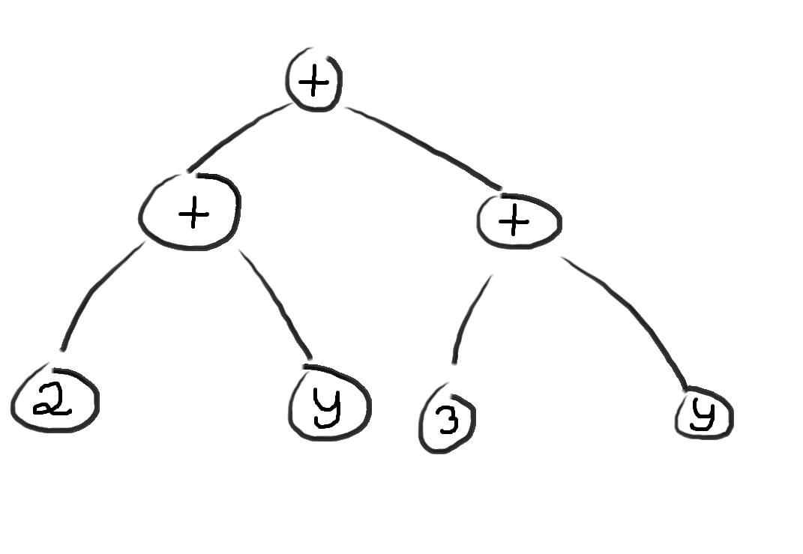
Preorder Traversal
Preorder traversal
Node – Left – Right
Prefix expression

Slide 43
Inorder Traversal
Inorder traversal
left, node, right.
infix expression
a+b*c+d*e+f*g

Slide 44
Inorder Traversal
Inorder traversal
left, node, right.
infix expression

Slide 45
Postorder Traversal
Postorder Traversal
left, right, node
postfix expression
abc*+de*f+g*+

Slide 46
Postorder Traversal
Postorder Traversal
left, right, node
postfix expression

Slide 47
Traversal Exercise
Traverse the following tree.
14
15
4
3
18
9
14
20
7
9
16
Pre-order Traversal?
Post-order Traversal?
In-order Traversal?
5
17
4
5

Slide 48
Binary Search Tree
Data Structures & Algorithms in C++

Slide 49
Binary Search Tree
Stores keys in the nodes in a way so that searching, insertion and deletion can be done efficiently.
Binary search tree is either empty or each node N of tree satisfies the following property
The Key value in the left child is not more than the value of root
The key value in the right child is more than or identical to the value of root
All the sub-trees, i.e. left and right sub-trees follow the two rules mention above.

Slide 50
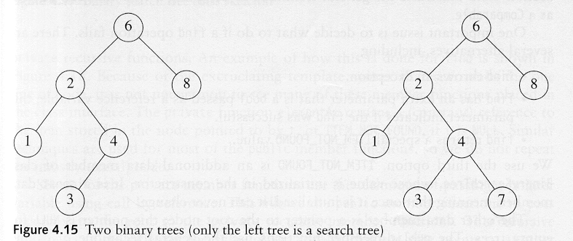
Examples
A binary search tree
Not a binary search tree

Slide 51
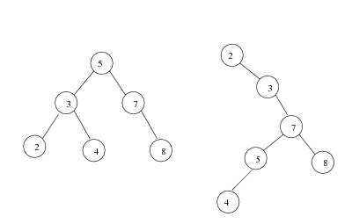
Example 2
Two binary search trees representing the same Data set:

Slide 52
Example
Input list of numbers:
14 15 4 9 7 18 3 5 16 4 20 17 9 14 5
14
15

Slide 53
Example
Input list of numbers:
14 15 4 9 7 18 3 5 16 4 20 17 9 14 5
14

Slide 54
Example
Input list of numbers:
14 15 4 9 7 18 3 5 16 4 20 17 9 14 5
14
4
15

Slide 55
Example
Input list of numbers:
14 15 4 9 7 18 3 5 16 4 20 17 9 14 5
14
4
15
9

Slide 56
Example
Input list of numbers:
14 15 4 9 7 18 3 5 16 4 20 17 9 14 5
14
4
15
9
7

Slide 57
Example
Input list of numbers:
14 15 4 9 7 18 3 5 16 4 20 17 9 14 5
14
4
15
9
18
7

Slide 58
Example
Input list of numbers:
14 15 4 9 7 18 3 5 16 4 20 17 9 14 5
14
4
15
3
9
18
7

Slide 59
Example
Input list of numbers:
14 15 4 9 7 18 3 5 16 4 20 17 9 14 5
14
4
15
3
9
18
7
5

Slide 60
Example
Input list of numbers:
14 15 4 9 7 18 3 5 16 4 20 17 9 14 5
14
4
15
3
9
18
7
16
5

Slide 61
Example
Input list of numbers:
14 15 4 9 7 18 3 5 16 4 20 17 9 14 5
14
4
15
3
9
18
7
16
5
4

Slide 62
Example
Input list of numbers:
14 15 4 9 7 18 3 5 16 4 20 17 9 14 5
14
4
15
3
9
18
7
16
20
5
4

Slide 63
Example
Input list of numbers:
14 15 4 9 7 18 3 5 16 4 20 17 9 14 5
14
4
15
3
9
18
7
16
20
17
5
4

Slide 64
Example
Input list of numbers:
14 15 4 9 7 18 3 5 16 4 20 17 9 14 5
14
4
15
3
9
18
7
9
16
20
17
5
4

Slide 65
Example
Input list of numbers:
14 15 4 9 7 18 3 5 16 4 20 17 9 14 5
14
4
15
3
9
14
18
7
9
16
20
17
5
4

Slide 66
Example
Input list of numbers:
14 15 4 9 7 18 3 5 16 4 20 17 9 14 5
14
4
15
3
9
14
18
7
9
16
20
17
5
4
5

Slide 67
Example
Input list of numbers:
14 15 4 9 7 18 3 5 16 4 20 17 9 14 5
14
4
15
3
9
14
18
7
9
16
20
17
5
“Binary Search Tree” of a given data set
4
5

Slide 68
Binary Tree Implementation
Class BinaryTree{
private:
struct node{
int data;
node* LTree;
node* RTree;
};
public:
node* root;
BinaryTree( ){ root = NULL; }
node* Insert(node* , int);
void Search(node* , int);
void InorderTraversal(node*);
void PreorderTraversal(node*);
void PostorderTraversal(node*);
};

Slide 69
Inorder Traversal Function
void BinaryTree::InorderTraversal(node* temp)
{
if(temp!=NULL)
{
InorderTraversal(temp->LTree);
cout<< temp->data;
InorderTraversal(temp->RTree);
}
}

Slide 70
Postorder Traversal Function
void BinaryTree::PostorderTraversal(node* temp)
{
if(temp!=NULL)
{
PostorderTraversal(temp->LTree);
PostorderTraversal(temp->RTree);
cout<< temp->data;
}
}

Slide 71
Preorder Traversal Function
void BinaryTree::PreorderTraversal(node* temp)
{
if(temp!=NULL)
{
cout<<temp->data;
PreorderTraversal(temp->LTree);
PreorderTraversal(temp->RTree);
}
}

Slide 72
Searching in Binary Search Tree
Three steps of searching
The item which is to be searched is compared with the root node. If the item is equal to the root, then we are done.
If its less than the root node then we search in the left sub-tree.
If its more than the root node then we search in the right sub-tree.
The above process will continue till the item is found or you reached end of the tree.

Slide 73
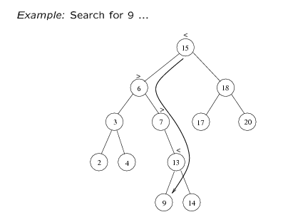
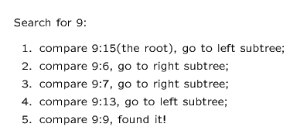

Slide 74
Search Function
void BinaryTree::Search(node* temp, int num)
{
if(temp==NULL)
cout<<“Number not found";
else if(temp->data == num)
cout<<"Number found";
else if(temp->data > num)
Search(temp->LTree, num);
else if(temp->data < num)
Search(temp->RTree, num);
}

Slide 75
Insertion in BST
Three steps of insertion
If the root of the tree is NULL then insert the first node and root points to that node.
If the inserted number is lesser than the root node then insert the node in the left sub-tree.
If the inserted number is greater than the root node then insert the node in the right sub-tree.

Slide 76
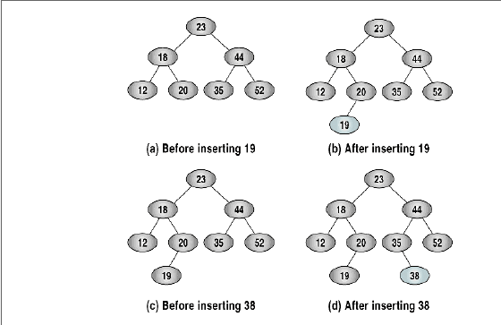

Slide 77
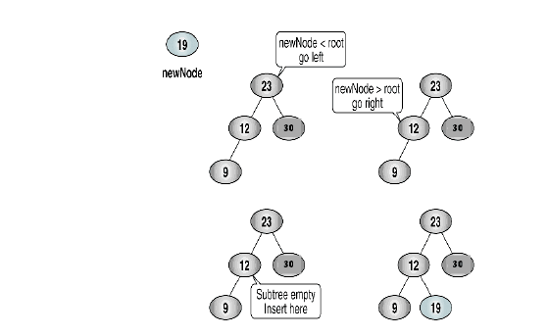

Slide 78
Insertion Function
node* BinaryTree::Insert(node* temp, int num)
{
if ( temp == NULL )
{
temp = new node;
temp->data= num;
temp->LTree= NULL;
temp->RTree=NULL;
}
else if(num < temp->data)
temp->LTree = Insert(temp->LTree, num);
else if( num >= temp->data)
temp->RTree = Insert(temp->RTree,num);
return temp;
}

Slide 79
Deletion in BST
When we delete a node, we need to consider how we take care of the children of the deleted node.
This has to be done such that the property of the search tree is maintained.

Slide 80
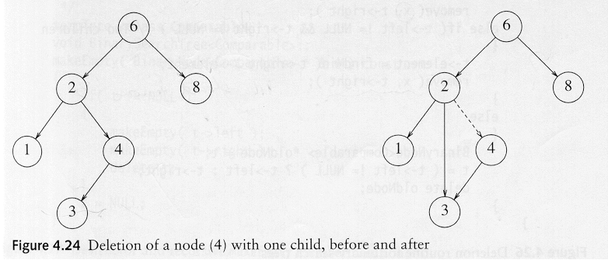
Deletion in BST
Three cases:
(1) The node is a leaf
Delete it immediately
(2) The node has one child
Adjust a pointer from the parent to bypass that node

Slide 81
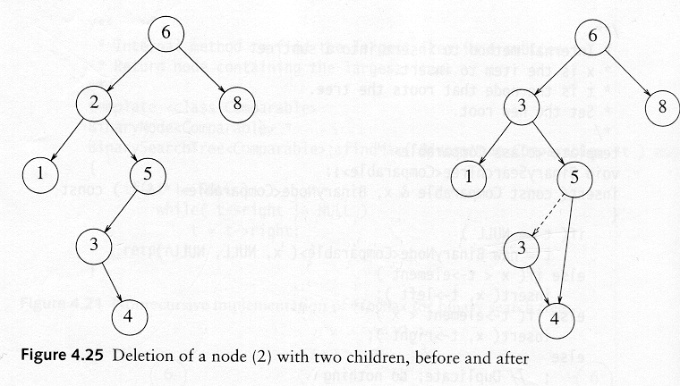
Deletion in BST
(3) The node has 2 children
Replace the key of that node with the minimum element at the right subtree
Delete the minimum element
Has either no child or only right child because if it has a left child, that left child would be smaller and would have been chosen. So invoke case 1 or 2.

Slide 82
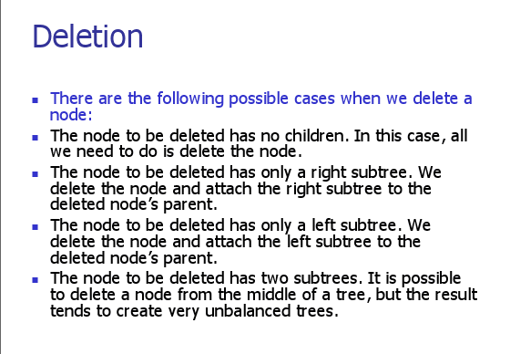

Slide 83
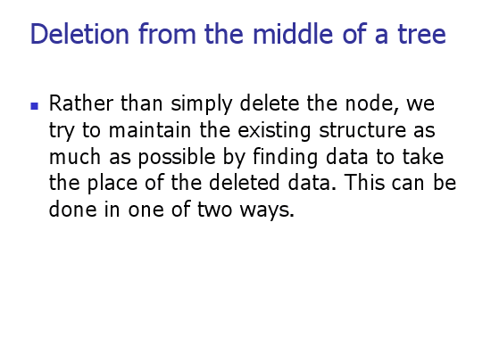

Slide 84
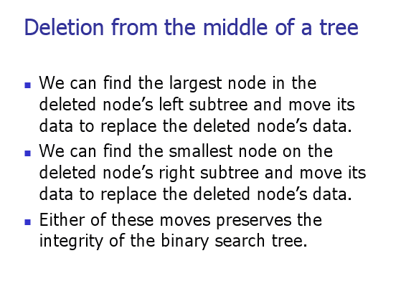

Slide 85
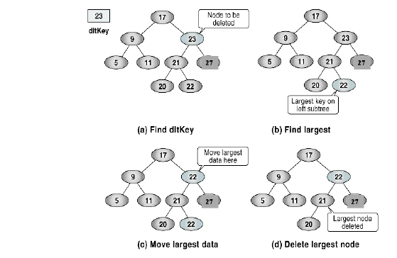

Slide 86
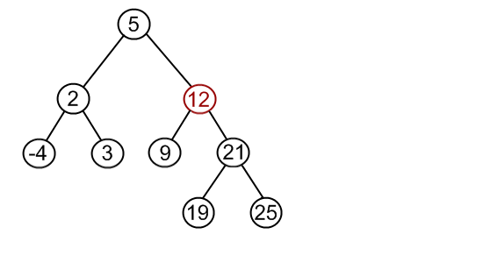

Slide 87
Deletion Code
void BTree::DeleteNode(node* temp, int num)
{ if (temp==NULL)
cout<<"Number not Found";
else if((temp->data == num))
{ node *parent, *min ;
int number;
// if number is found at a leaf node
if((temp->LTree == NULL) && (temp->RTree == NULL))
{
parent=GetParent(root, temp->data, root); //will return parent node
if(parent->LTree == temp)
parent->LTree = NULL;
else if (parent->RTree == temp)
parent->RTree = NULL;
delete temp;
}

Slide 88
// if node to be deleted has one child
else if(((temp->LTree == NULL) && (temp->RTree != NULL)) || ((temp->LTree != NULL) && (temp->RTree == NULL)))
{
parent = GetParent(root, temp->data, root); //will return parent node
if(temp->LTree != NULL){
if(parent->LTree == temp)
parent->LTree = temp->LTree;
else if (parent->RTree == temp)
parent->RTree = temp->LTree;
}
else if(temp->RTree != NULL){
if(parent->LTree == temp)
parent->LTree = temp->RTree;
else if (parent->RTree == temp)
parent->RTree = temp->RTree;
}
delete temp;
}

Slide 89
//if node to be deleted has two children
else if((temp->LTree != NULL) && (temp->RTree != NULL))
{
min = FindMin(temp->RTree); //will return the min. no. found in RTree
number = min->data;
DeleteNode(temp->RTree, min->data); //calling to itself recursively
temp->data= number;
}
}
else if (num < temp->data)
DeleteNode(temp->LTree, num); //calling to itself recursively
else if (num > temp->data)
DeleteNode(temp->RTree, num); //calling to itself recursively
}

Slide 90
-End-

